Slide 1

A/B Testing – High Yield CD
Compare and Rates on the Overview Tab
Team:
Bethany Dixon……....e-Commerce US Deposits
Virginia Wilson……....Delivery
Steve Schang………..Usability
Michelle Downey…….IA
John Brennan……......Copy
Jessica Motsinger/Levi Flair……....Design
Post Governance / Final Version
Governance Review: January 20, 2012
© 2011 Ally Financial — Proprietary and confidential

Slide 2

Test Summary
Elements | Description
Test Name | Test 1: Rates & Compare Tab information on HYCD Overview
Objective | Determine the impact of integrating Ally and competitor product rates and comparisons on the HYCD Overview Tab.
Hypothesis | From the HYCD Overview Tab, the Rates Tab has high traffic numbers, suggesting users are interested in that content. The Compare Tab has a significantly lower exit rate, showing that users are more likely to stay on the site from this tab. Testing will determine which information should be surfaced to the HYCD Overview Tab and will provide insight about whether the presence of Rates or Compare Tab information is beneficial in driving account opens. It is hypothesized that adding Ally and competitor rates to the HYCD Overview page will increase the number of App Starts from that page. It is also expected that the total exit rate from the Overview tab will be impacted depending on the experience.
© 2011 Ally Financial — Proprietary and confidential
© 2011 Ally Financial — Proprietary and confidential

Slide 3
Test Plan
Elements | Description
Test Location | High Yield CD Overview Tab http://www.ally.com/bank/high-yield-cd/
Metrics | Page views, pathing reports of the next page visited, and volume of Apps Started & Apps Committed.
Target Audience | This test shall measure all traffic, but have the ability to segment results according to population type – Direct Traffic & Marketing-Driven. The target audience shall not limit the focus primarily on prospects, defined as users who come directly from a marketing campaign, have not visited any authenticated space, do not have existing Ally Bank cookies on their browser, or are first time visitors to the site. The test experiences shall be evenly split between these populations as a whole.
Constraints | Depending on the timing of launch, the traffic skew from releases and marketing campaigns shall be taken into consideration. Upcoming initiatives includes direct marketing and email campaigns for IRA products, and potentially the launch of Mobile Banking.
Time Frame | The test shall be originally slated to run for 6 weeks, with an evaluation of whether to continue after 4 weeks.
© 2011 Ally Financial — Proprietary and confidential
© 2011 Ally Financial — Proprietary and confidential

Slide 4
Test Experiences
 | Information Surfaced | Visual Design | Default State
Experience A | Control | Control | Control
Experience B | Rates | Bar Graph | Open / Static
Experience C | Compare | Bar Graph | Open / Static
© 2011 Ally Financial — Proprietary and confidential
© 2011 Ally Financial — Proprietary and confidential

Slide 5
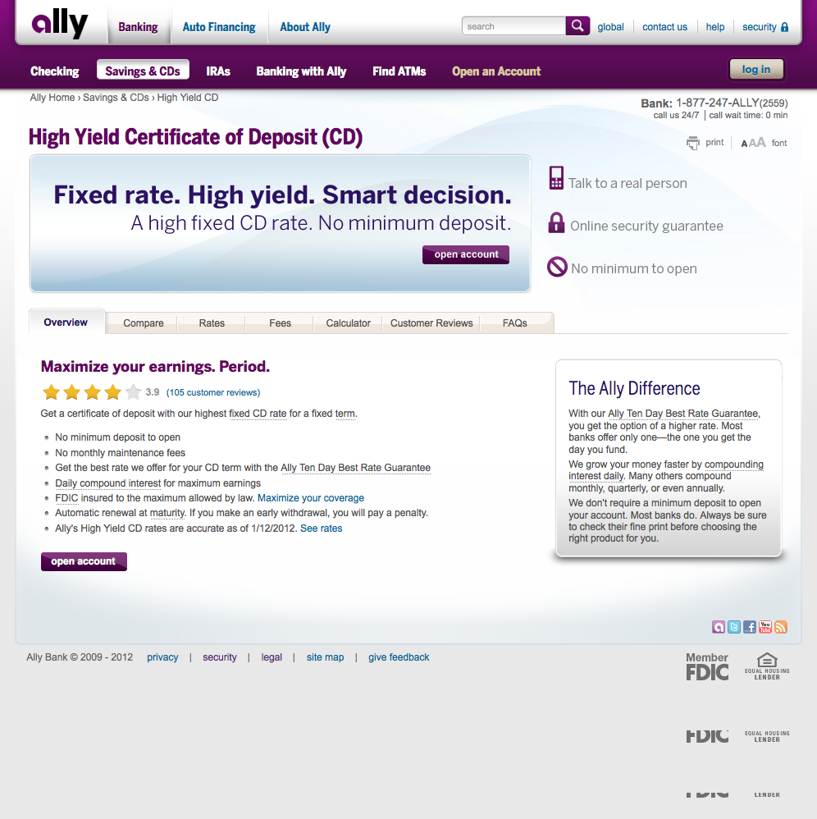

Current State: HYCD Overview
© 2011 Ally Financial Proprietary and Confidential
© 2011 Ally Financial — Proprietary and confidential
© 2011 Ally Financial — Proprietary and confidential

Slide 6
Compare Tab Information
© 2011 Ally Financial — Proprietary and confidential

Slide 7
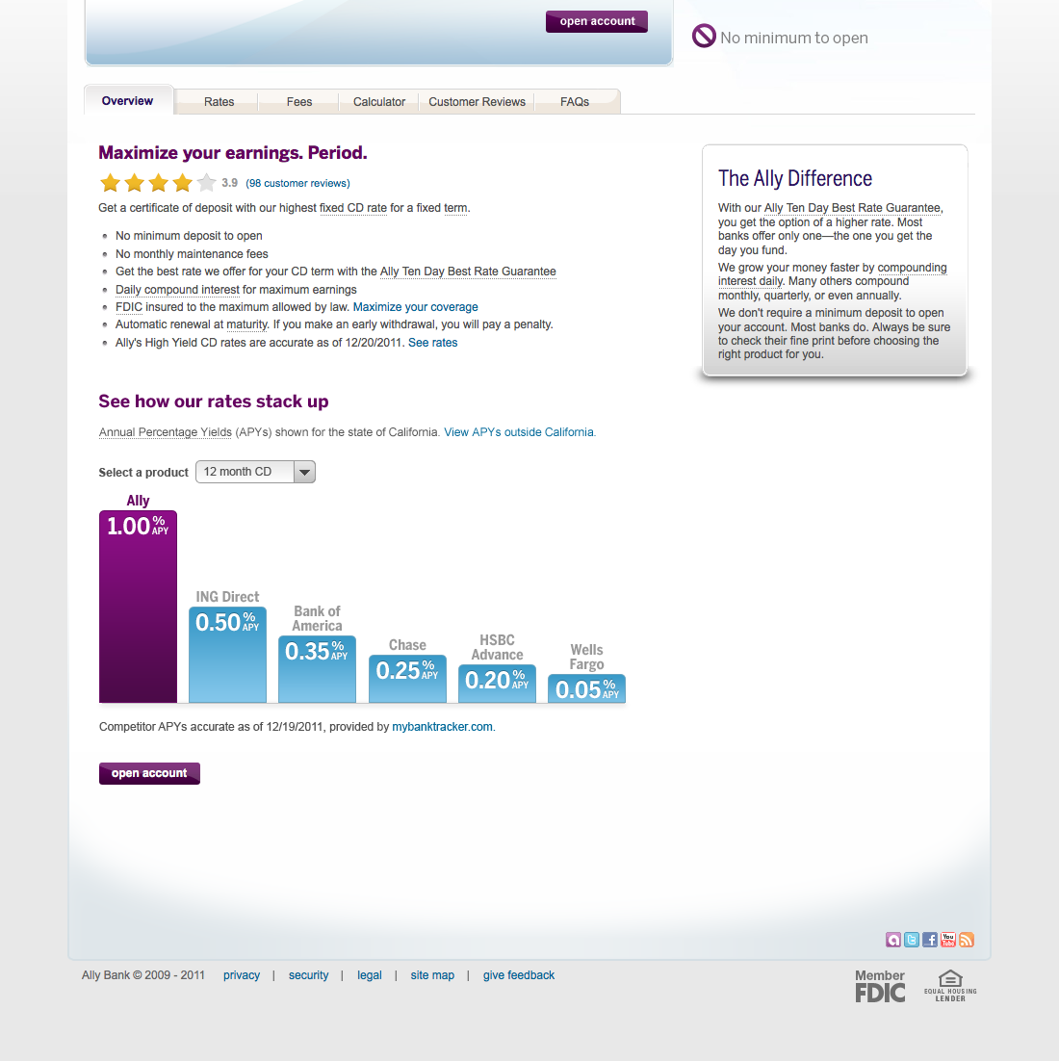

Compare tab removed
Details visible on page load
Link in last bullet revised to: “See rates below” and scrolls down to graph
Compare:
Static Bar Graph
© 2011 Ally Financial Proprietary and Confidential
© 2011 Ally Financial — Proprietary and confidential
© 2011 Ally Financial — Proprietary and confidential

Slide 8
Rates Tab Information

Slide 9
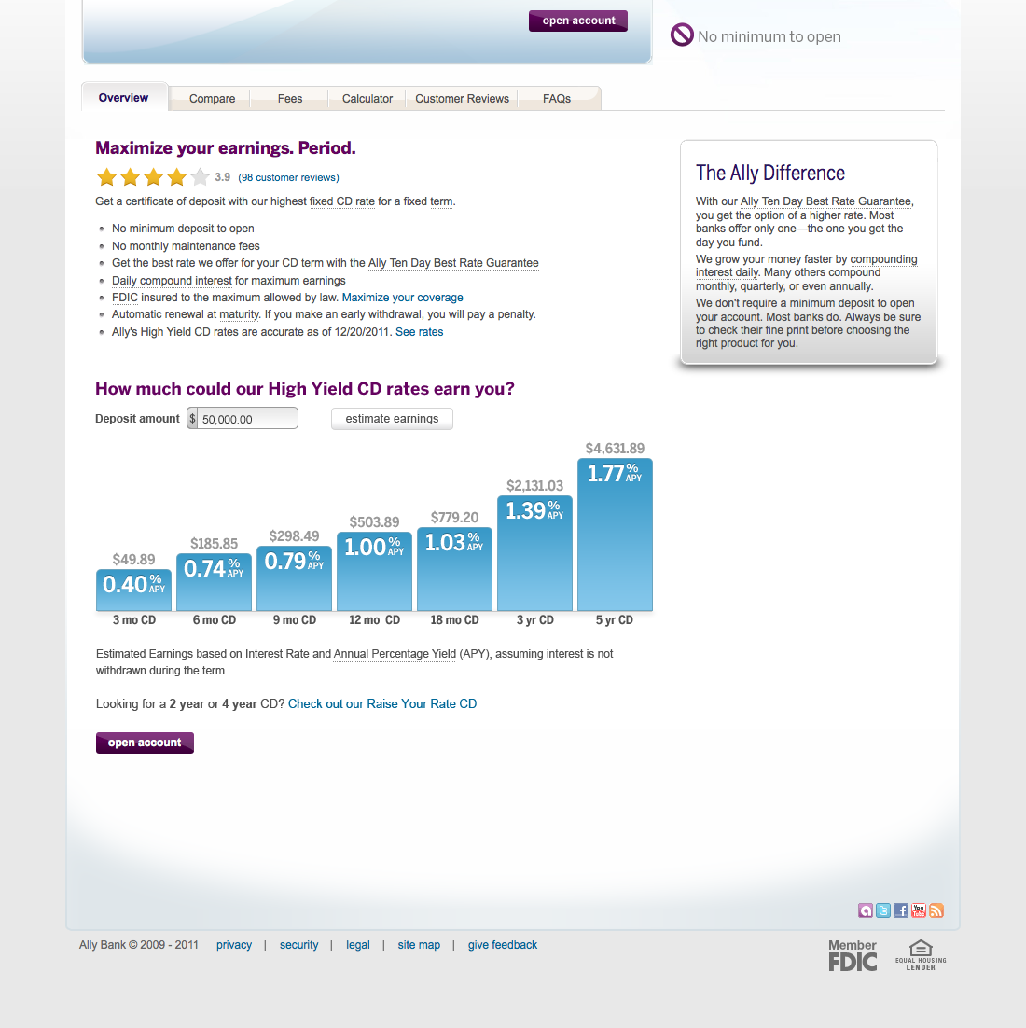
Rates tab removed
Details visible on page load
Link in last bullet revised to: “See rates below” and scrolls down to graph
Rates:
Static Bar Graph
© 2011 Ally Financial Proprietary and Confidential
© 2011 Ally Financial — Proprietary and confidential
© 2011 Ally Financial — Proprietary and confidential

Slide 10
Appendix

Slide 11
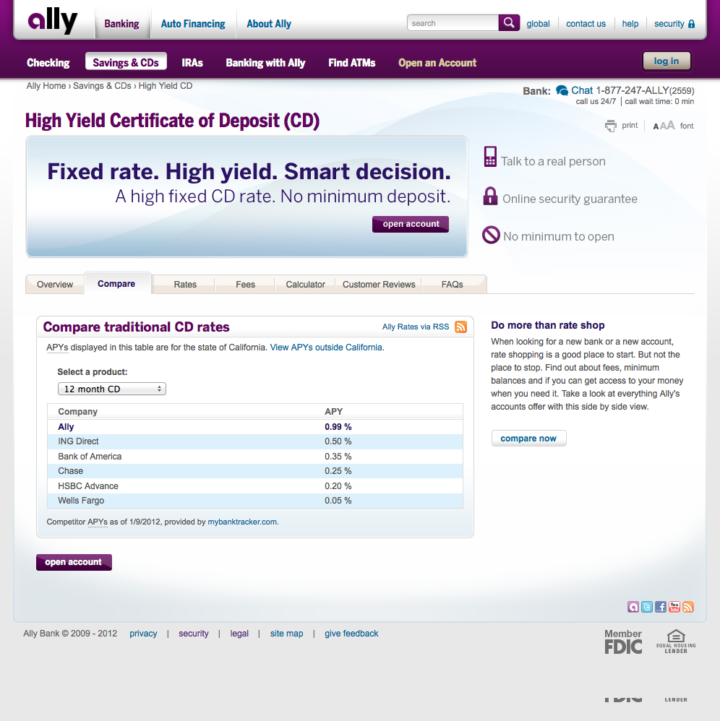
Current State:
HYCD Compare
© 2011 Ally Financial Proprietary and Confidential
© 2011 Ally Financial — Proprietary and confidential
© 2011 Ally Financial — Proprietary and confidential

Slide 12
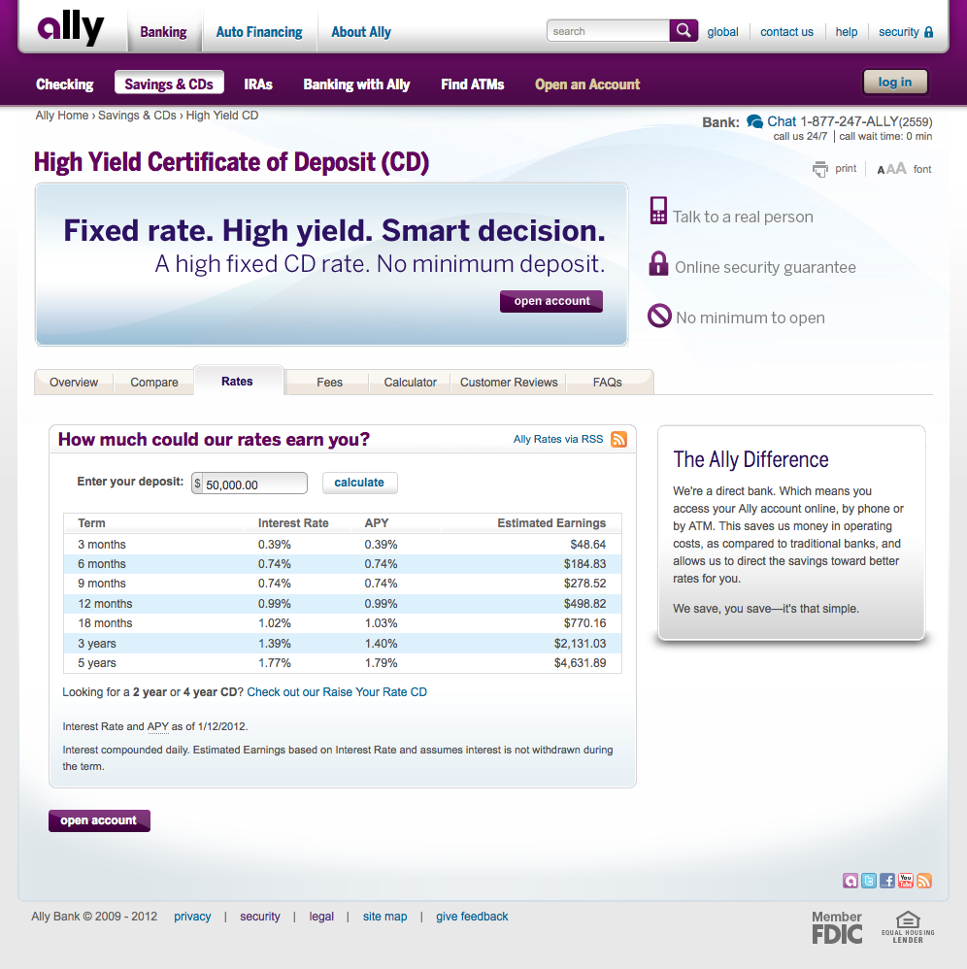
Current State: Rates
© 2011 Ally Financial Proprietary and Confidential
© 2011 Ally Financial — Proprietary and confidential
© 2011 Ally Financial — Proprietary and confidential

